Slide 1
Preprinting and Publishing in the Life and Biomedical Sciences
The editorial process
and peer review

Slide 2





In today’s lesson we will discuss:
The editorial process and scientific peer review
The inner workings of the journal editorial process and the roots of modern peer review
Challenges impacting existing models of peer review and journal workflows
Emerging innovations and best practice in peer review and transparent editorial processes
Hands-on peer review workshop

Slide 3
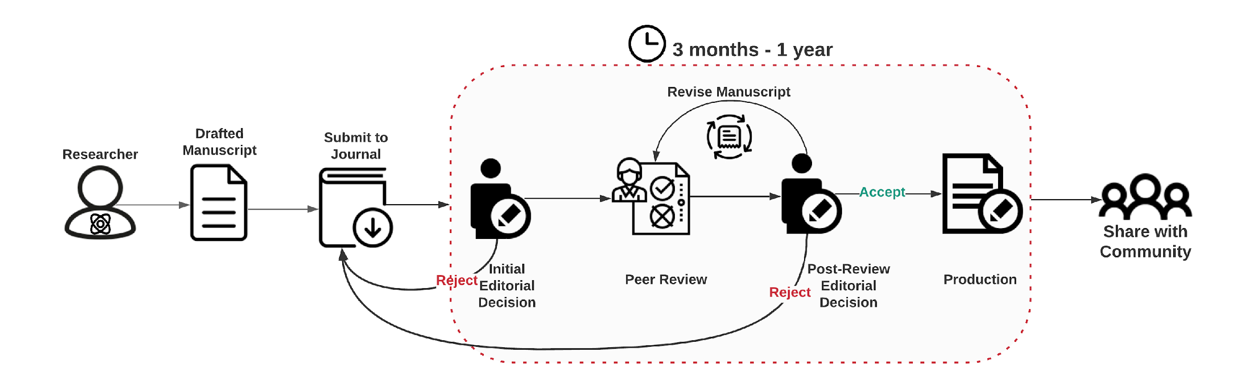
The traditional journal-dependent manuscript lifecycle
Notes:
Welcome to the manuscript editing lifecycle. This course’s section will give you an overview of editorial steps that take place after you submit your manuscript to a journal.
Through this presentation, we aim to understand the following:
• the role(s) of the editor
• the importance of editing in the publication process
• how the publication process can take advantage of preprints
1. The manuscript lifecycle can be divided into the following steps:
a. Initial evaluation
i. desk-rejection
ii. return to author for amendments
iii. accept for review
b. Editor assignment and peer review
c. Reviews and revisions
i. peer review
d. Reviews and revisions
i. returning revisions
ii. barriers to acceptance after revision
e. Acceptance and prepublication editing
f. Production

Slide 4
The traditional journal-dependent manuscript lifecycle: The editorial process
Initial Evaluation
Notes:
Welcome to the manuscript editing lifecycle. This course’s section will give you an overview of editorial steps that take place after you submit your manuscript to a journal.
Through this presentation, we aim to understand the following:
• the role(s) of the editor
• the importance of editing in the publication process
• how the publication process can take advantage of preprints
1. The manuscript lifecycle can be divided into the following steps:
a. Initial evaluation
i. desk-rejection
ii. return to author for amendments
iii. accept for review
b. Editor assignment and peer review
c. Reviews and revisions
i. peer review
d. Reviews and revisions
i. returning revisions
ii. barriers to acceptance after revision
e. Acceptance and prepublication editing
f. Production

Slide 5



Initial editorial evaluation
Technical checks
Initial technical checks ensure that the submission includes all files and information required by the journal.
This process is usually administrative and the submission is returned to the authors for necessary amendments.
Required disclosures
competing interests
ethics approval
authors' contributions
availability of data
funding information
Text overlap (plagiarism)
File completeness
Initial editorial evaluation
After the technical checks, the manuscript is sent to an editor:
Scope
Is the manuscript suitable for the disciplinary focus of the journal?
Are there specific requirements for novelty/advance, does the work meet the expected level?
Editorial policies
Are all policies met? E.g., regarding ethical requirements, data availability or other
The editor will make an initial decision:
All requirements met ⇒ proceed to peer review
Scope and/or policies not met ⇒ desk reject, the journal notifies the author
This step takes from 1-2 days up to a couple of weeks
Notes:
Suggestion to instructor: build through animation

Slide 6
The traditional journal-dependent manuscript lifecycle: The editorial process
Editor Assignment

Slide 7





Editors – a central hub in the journal-dependent publication process
Researcher
Peer Review
Editor
Scientific Community
Publisher

Slide 8
The various types of editors: What do they do?
Editors
Scientific editors
Production editors
Editor in chief
Developmental editor
Associate/academic editor
Content editor
Before acceptance
Copyeditor
Evaluation of suitability for publication according to the scientific content and editorial scope and requirements
Proofreader
Post acceptance
Ensure compliance with language requirements and style guidelines such as AMA and APA
Notes:
After the initial checks, the manuscript is assigned to an editor that will handle the review process and communication with authors. Let’s take a look on the roles academic editors play in this process. Here we will group editors as scientific editors and production editors.
Note that, usually, scientific editors’ work takes place before acceptance, whereas production editors’ work takes place after acceptance.
The expertise lent and the extension of the revisions made define the role of an editor. The attributions and position title of an editor can vary greatly from journal to journal, therefore, the division presented here is an example, not stone-written rules. Moreover, the smaller the journal the more editors’ roles tend overlap. In this context, editors in chief could also work as developmental editors, whereas content editors would be more like associate editors, plus copyediting and proofreading tasks for both. Big publishers/journals tend to outsource services performed by production editors to academic publishing companies because it can be cost-effective and performed entirely after acceptance, not interfering with journal’s decisions.
Scientific editors are the ones we, as writers, reach when submitting a manuscript to a journal. They can be editors in chief or associate editors (and other position’s titles exist, it’s very particular of each publisher/journal), and their main responsibility is concerning scientific aspects of a given paper (eg, novelty, quality of evidence, and contribution to the field). They will perform the initial triage and send the manuscript to review or reject it. Workflows may begin with the editor in chief performing the initial triage, then assigning the manuscript to an associate editor who will handle reviewers’ assignments and the related communication.

Slide 9

Scientific Editors
The Editor-in Chief and the Associate/Academic Editors act as gatekeepers for the journal
They curate content i.e. make decisions on what gets published in the journal
They uphold the journal’s policies and thus look after the journal’s reputation
In addition to handling the editorial process for individual manuscripts, they also:
Invite colleagues to submit to the journal
Invite colleagues to review for the journal or join its editorial board
Commission non-research manuscripts such as narrative reviews and commentaries
Keep abreast of the latest literature and developments in their field and make recommendations for commissioned content or editorial policy needs
Represent the journal at conferences and meetings
Suggest topics for and/or manage special issues at the journal - collections of publications around a specific theme, usually time bound

Slide 10
Editor-in-Chief
Overall responsibility for editorial content at the journal
Ultimate say on editorial decisions
Sets strategy and direction for the journal
Drives and oversees development of journal scope and editorial policies
May be more or less involved in manuscript handling depending on the journal structure and size
Public face for the journal
May be academic (a recognized leader in the field served by the journal) or professional (an employee of the journal or publisher)
Supported by an editorial board - a group of Academic Editors/Associate Editors who handle individual manuscripts and provide input on scope and editorial policies
Notes:
The most important aspect of scientific editor’s and editorial boards’ work concerns the curation role attributed to them. Check the “Aims and Scope” statement of any journal; there you can have a look at what the journal wants to accomplish.
“Scope,” simply stated, is the journal’s purpose or objective. This is what the publication wants to achieve by delivering its content to its readers. Also known as “aim” or “mission,” a journal’s goals contain many factors you will want to consider when deciding if the journal is right for you. For example, Nature‘s scope states the following:
Nature is a weekly international journal publishing the finest peer-reviewed research in all fields of science and technology on the basis of its originality, importance, interdisciplinary interest, timeliness, accessibility, elegance and surprising conclusions. Nature also provides rapid, authoritative, insightful and arresting news and interpretation of topical and coming trends affecting science, scientists, and the wider public.
Here, we can see:
the frequency of the publication (weekly),
the circulation size (international),
the type of review (peer review),
the criteria for selection (“originality, importance, interdisciplinary interest, timeliness, accessibility, elegance and surprising conclusions”), and
the types of articles it publishes (news, research articles [“research in all fields of science and technology”] and editorials and commentaries [“interpretation of topical and coming trends”]).
The journal also includes a mission statement:
First, to serve scientists through prompt publication of significant advances in any branch of science, and to provide a forum for the reporting and discussion of news and issues concerning science. Second, to ensure that the results of science are rapidly disseminated to the public throughout the world, in a fashion that conveys their significance for knowledge, culture and daily life.
Based on the above, we also learned that its audience includes not only scientists but also the general public. Moreover, its content aims to improve our understanding of culture and daily life.

Slide 11
Associate/Academic Editors
The Associate or Academic Editors are researchers with expertise in the field(s) covered by the journal
They manage the editorial process and peer review for individual manuscripts:
Make initial decisions on whether to proceed to peer review or desk reject
Identify reviewers for the manuscript
Make a decision on whether to publish the manuscript, informed by the reviewer’s comments and their assessment of the manuscript and the journals’ requirements
Liaise with authors about specific editorial requests, or queries the authors may have
Handle complaints and appeals on editorial decisions

Slide 12
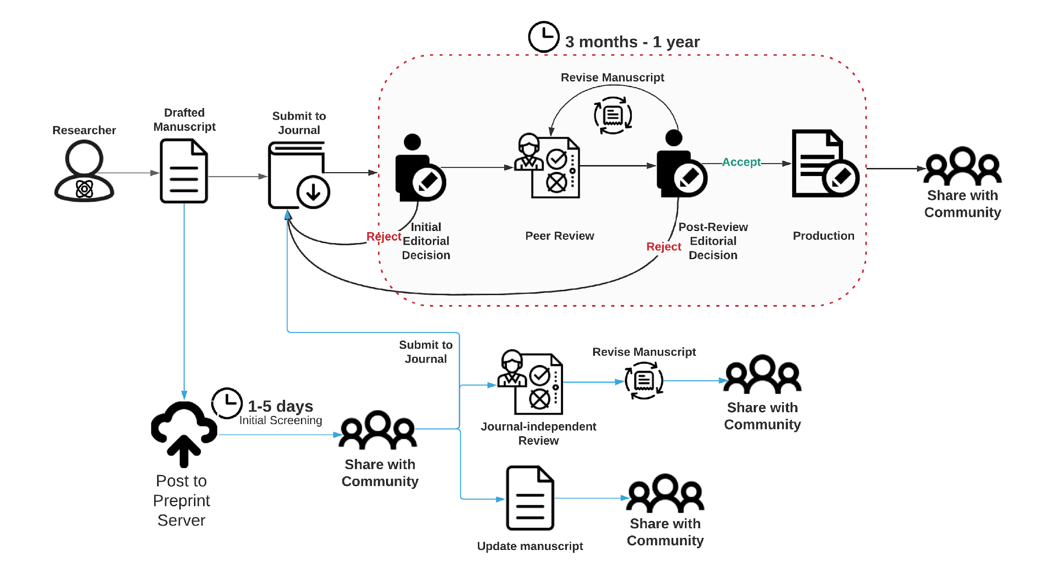
Can preprinting benefit the editorial process?
Preprints can inform editors in the initial editorial decision
Public comments on preprint servers or social media discussion can aid peer review
Public discussion can help editors identify relevant reviewers
Notes:
More info for editorial decisions
Discussion of preprints in the community
Metrics for downloads
Comments on social media or comment sections on preprint servers
Facilitated discussion might aid in identifying relevant peer reviewers

Slide 13
The traditional journal-dependent manuscript lifecycle: The peer review process
Peer Review

Slide 14
Editors play a critical role in the peer review process
“Editors are responsible for monitoring and ensuring the fairness, timeliness, thoroughness, and civility of the peer-review editorial process.”
- Council of Science Editors, White Paper on Publication Ethics
Notes:
https://www.councilscienceeditors.org/resource-library/editorial-policies/white-paper-on-publication-ethics/2-1-editor-roles-and-responsibilities/#2112

Slide 15
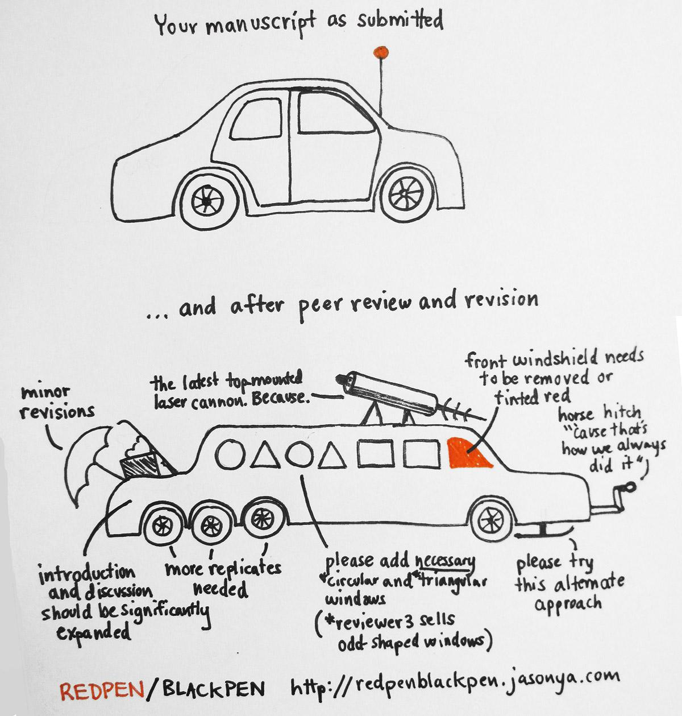
Peer review
What is peer review?
Many scientists’ first exposure to peer review is on the receiving end. Do we understand how peer review works - and how it should work in an ideal world?
The idea of peer review as the gatekeeper for a stable repository of human knowledge is not as old as it might seem!

Slide 16
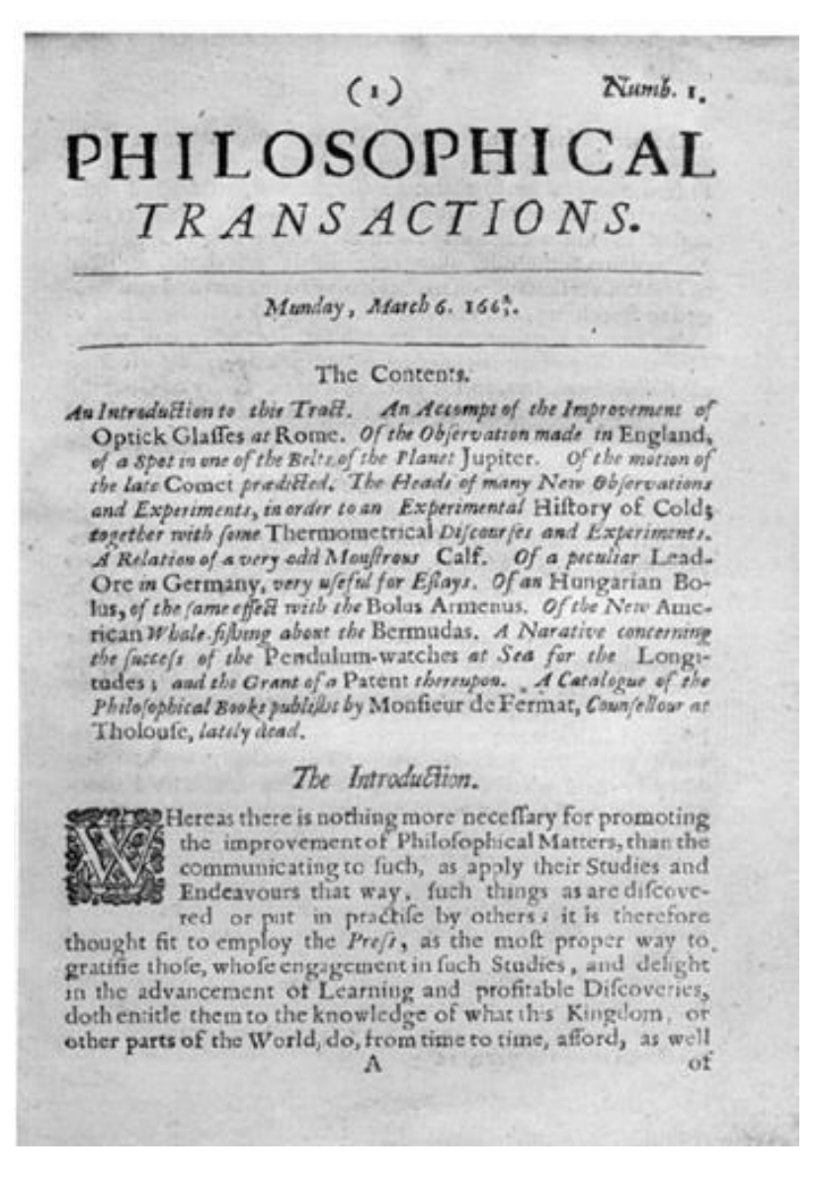
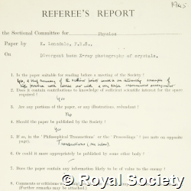
The history of peer review
Modern peer review was born at the Royal Society in the mid-1600s…
[…it was determined that “… [articles in the Society’s Philosophical Transactions should be] first reviewed by some of the members of the same” (Royal Society Order in Council 1/3/1665)]
…and hasn’t changed all that much since.

Slide 17
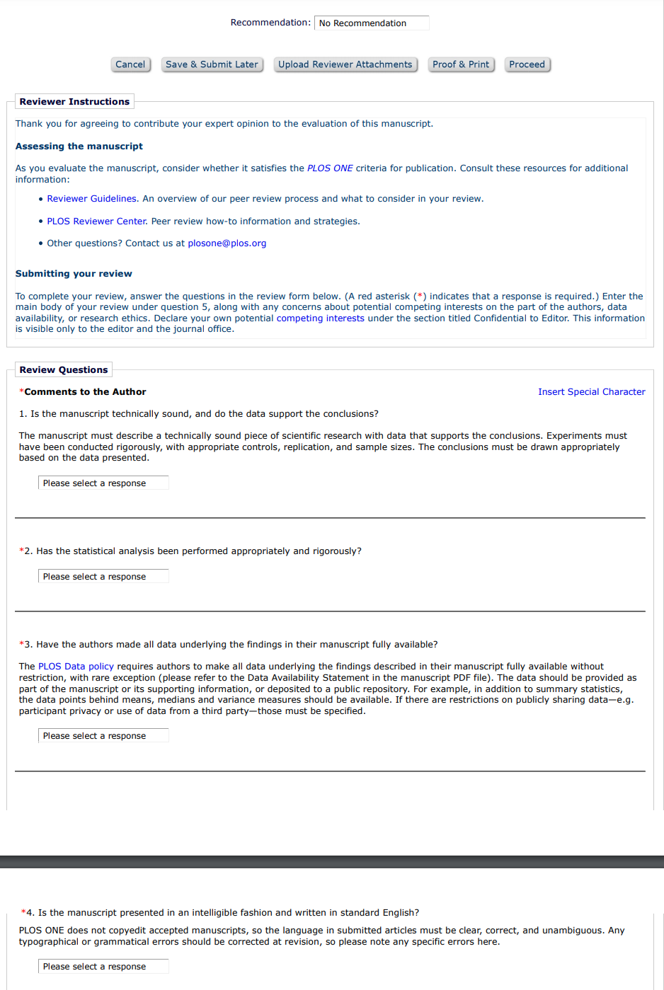
What is a peer review?
An evaluation of the manuscript completed by an expert in the field
As part of the editorial process, the editor will invite experts (peers) to provide a report (review) on the manuscript
Most journals aim to obtain 2-3 reviews
Ideally the reviewer should be knowledgeable in the area of work of the manuscript and able to provide an objective review i.e. free of a comparing interest or bias
Reviewers may agree or decline depending on their expertise and availability, journals often invite multiple reviewers until 2-3 agree
Reviewers are usually given 10-21 days to complete the review (deadlines vary per journal)
The format of the review will vary per journal:
Free text
Review form requesting that specific items are covered
Possibility (or not) to provide confidential comments to the editor
PLOS ONE reviewer form https://plos-marketing.s3.amazonaws.com/Marketing/plosone-reviewer-form.pdf

Slide 18
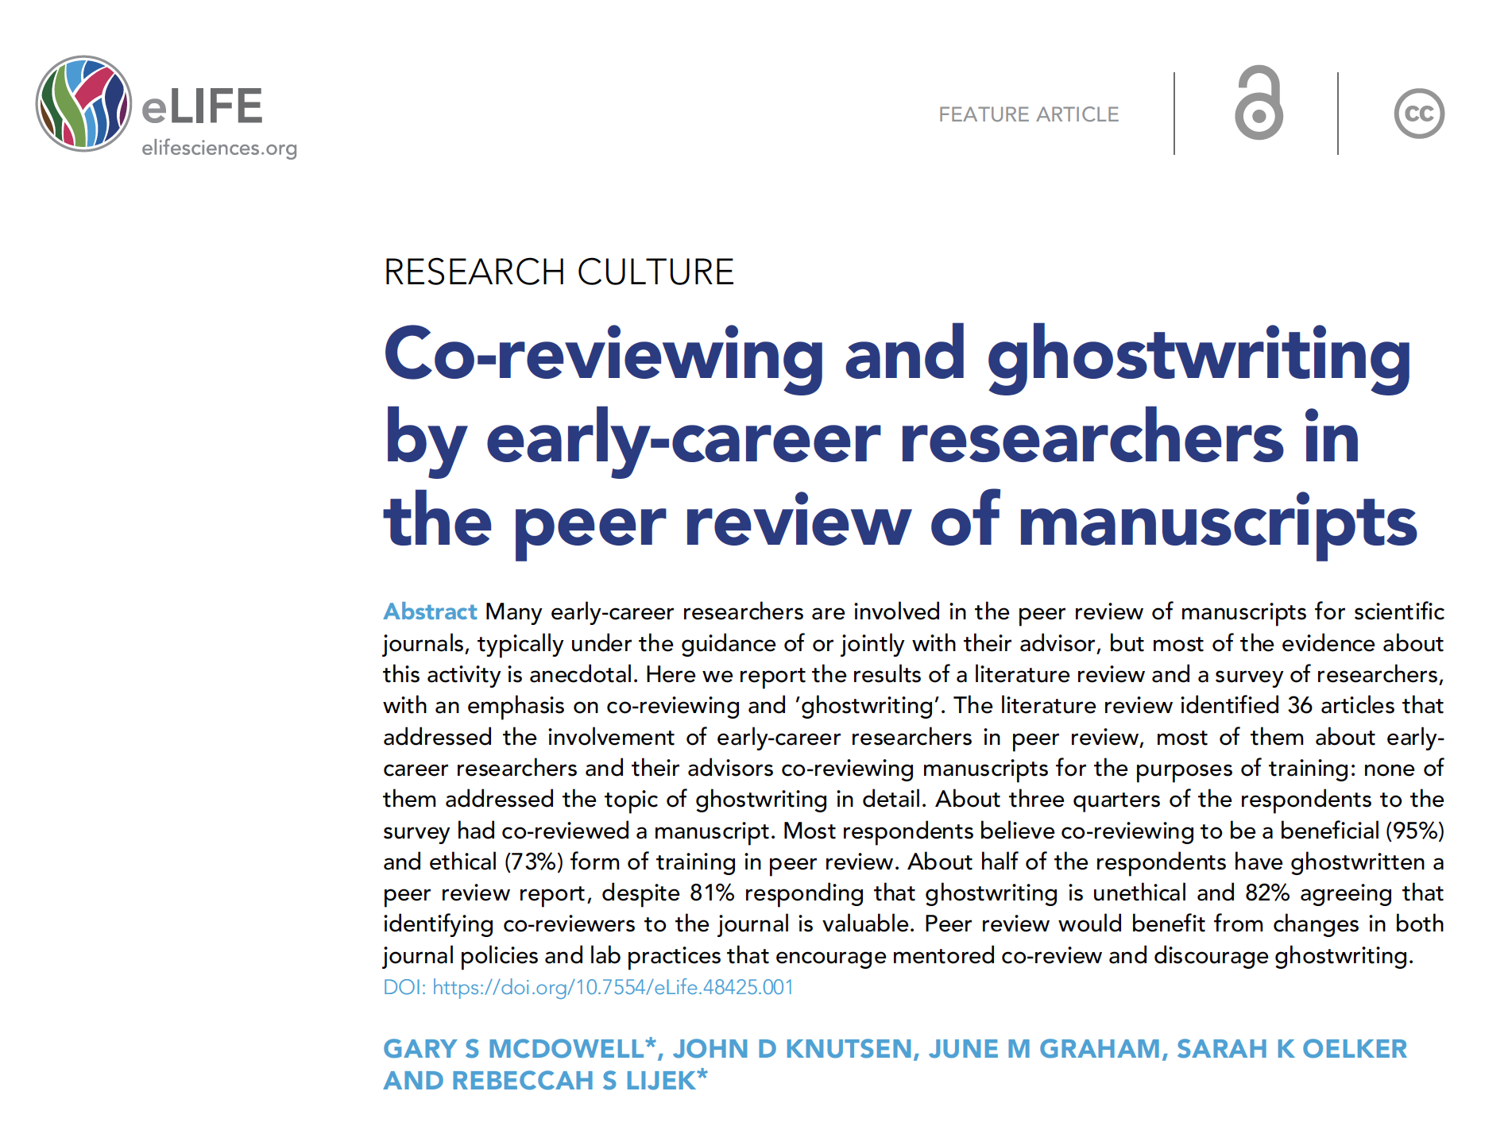
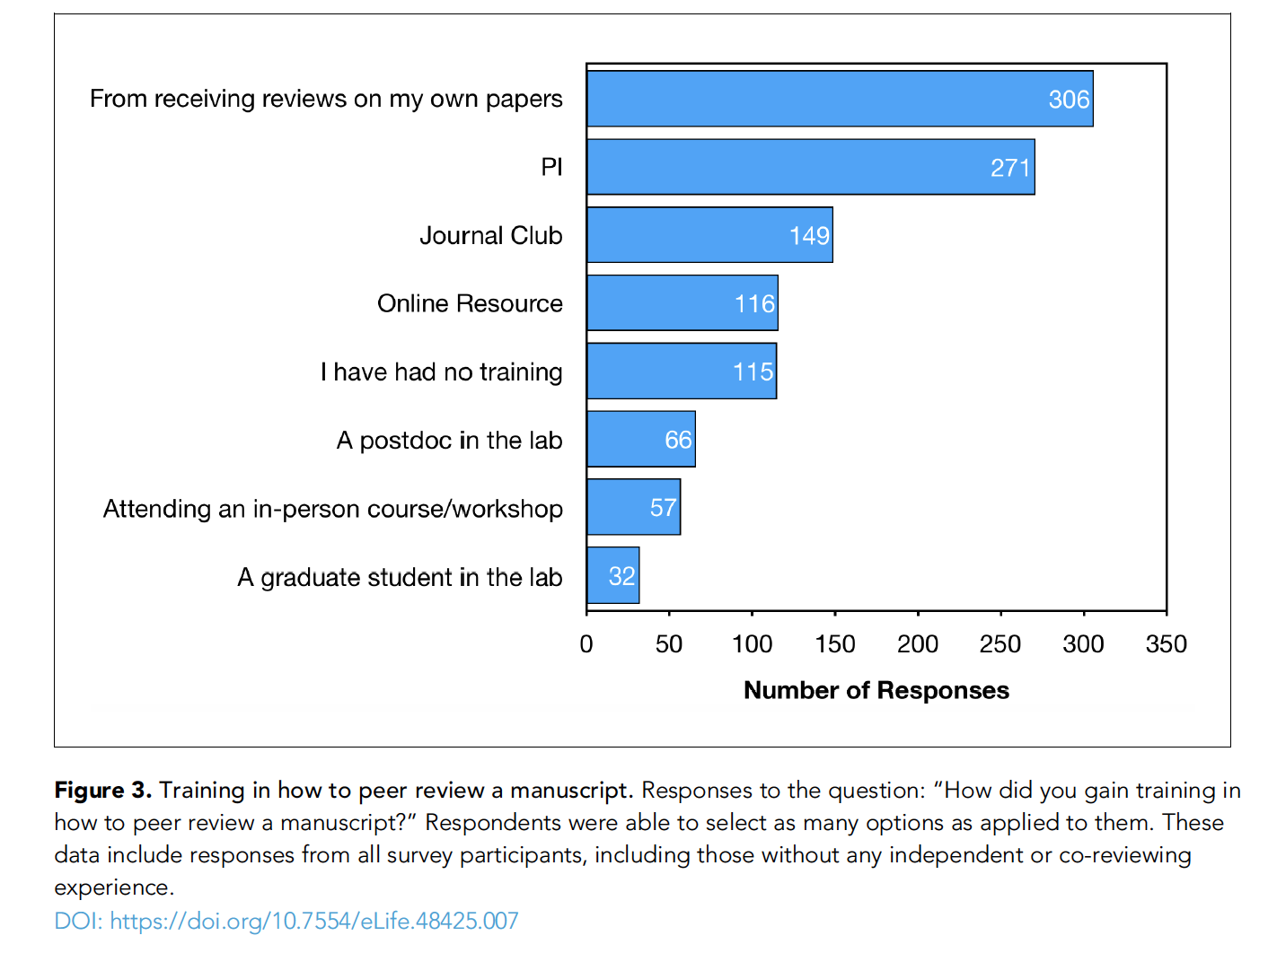
(In)formal training in peer review
Several new training resources available and/or in development!
Notes:
https://plos.org/resources/for-reviewers/
https://content.prereview.org/programs/

Slide 19
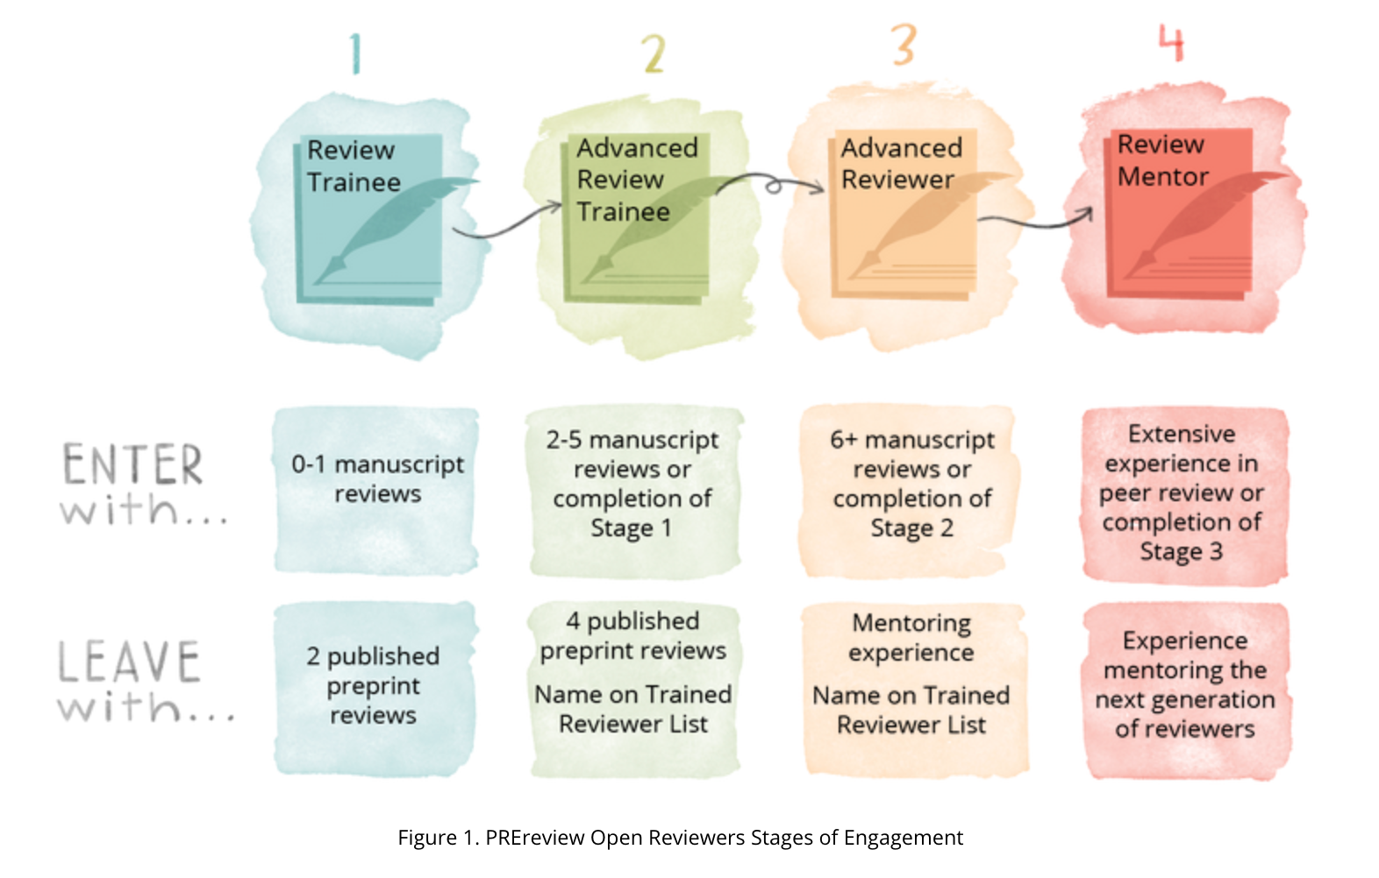
Training and certification in peer review
Some examples…
PREreview Open Reviewers mentorship programme
IOP Peer Review Certification
PLOS Peer Review Centre

Slide 20
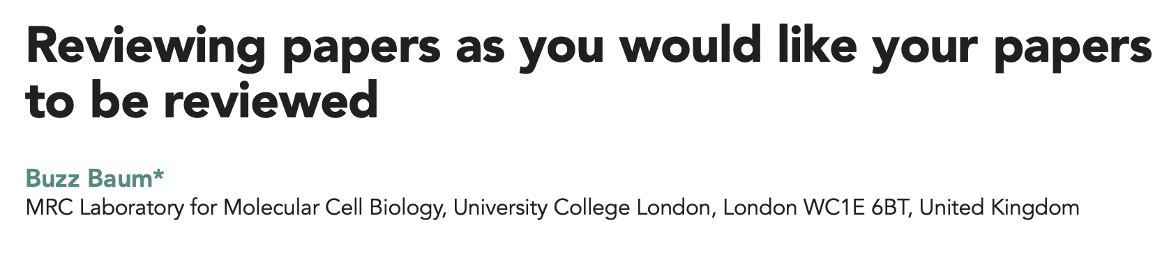
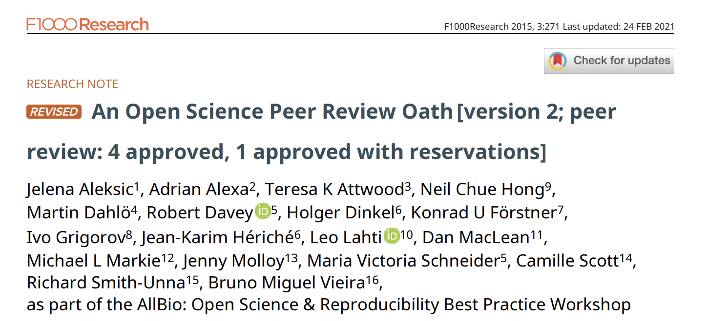
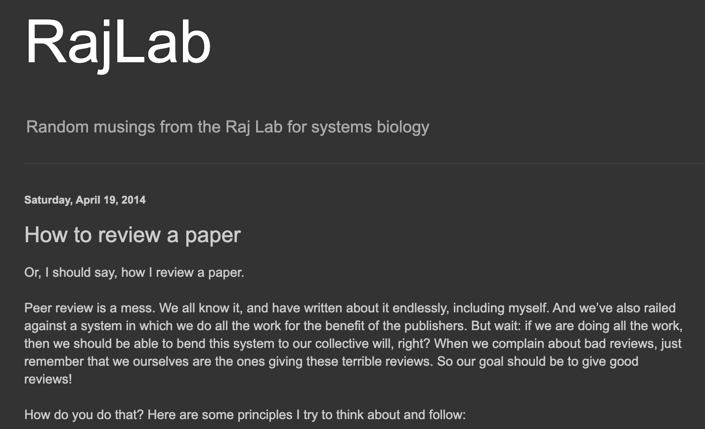
Reviewer best practice
Would you publicly commit to a set of principles that guide you as a peer reviewer?
Link to sample reviewer oath
Notes:
Discuss these ideas – it is just one example. Do we agree?

Slide 21

Peer review and editorial decision
Peer reviewers will submit their reports to the editor, the reports include:
An assessment of the manuscript
Comments on any potential concerns or flaws, questions or requests for the authors
A recommendation on whether the manuscript is suitable for publication in the journal
Once all the reviews are available, the editor will make an editorial decision, informed by the reviewers’ comments, their own assessment of the manuscript and the editorial policies at the journal:
Accept - the manuscript will be published
Revision - the manuscript does not yet meet all the journal requirements, the authors are asked to make revisions to address remaining items, requests for revisions may be
Major - usually requiring additional data or major changes to the interpretation
Minor - usually involving clarifications or changes to the text
Reject - the manuscript does not meet the journal requirements, and
The editor will notify the authors with a decision letter including the decision, the editor's’ comments and the peer reviews
This stage can take from 3-4 weeks to several months, timelines vary per manuscript and discipline

Slide 22
Evolving formats of peer review

Slide 23
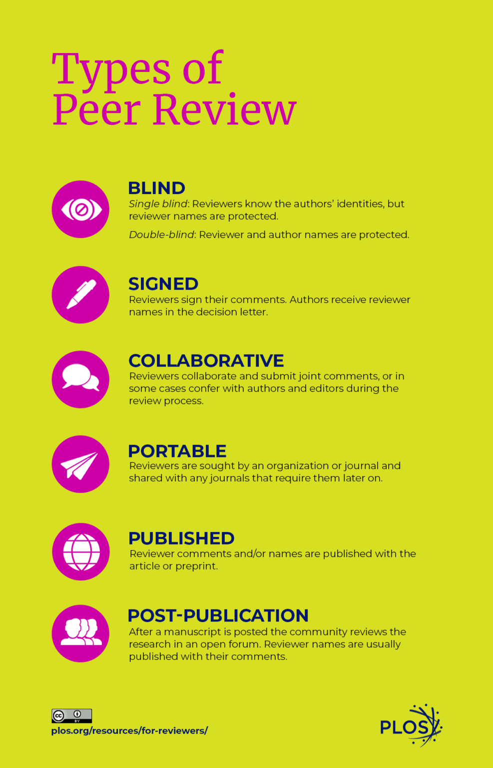
Evolving formats of peer review

Slide 24

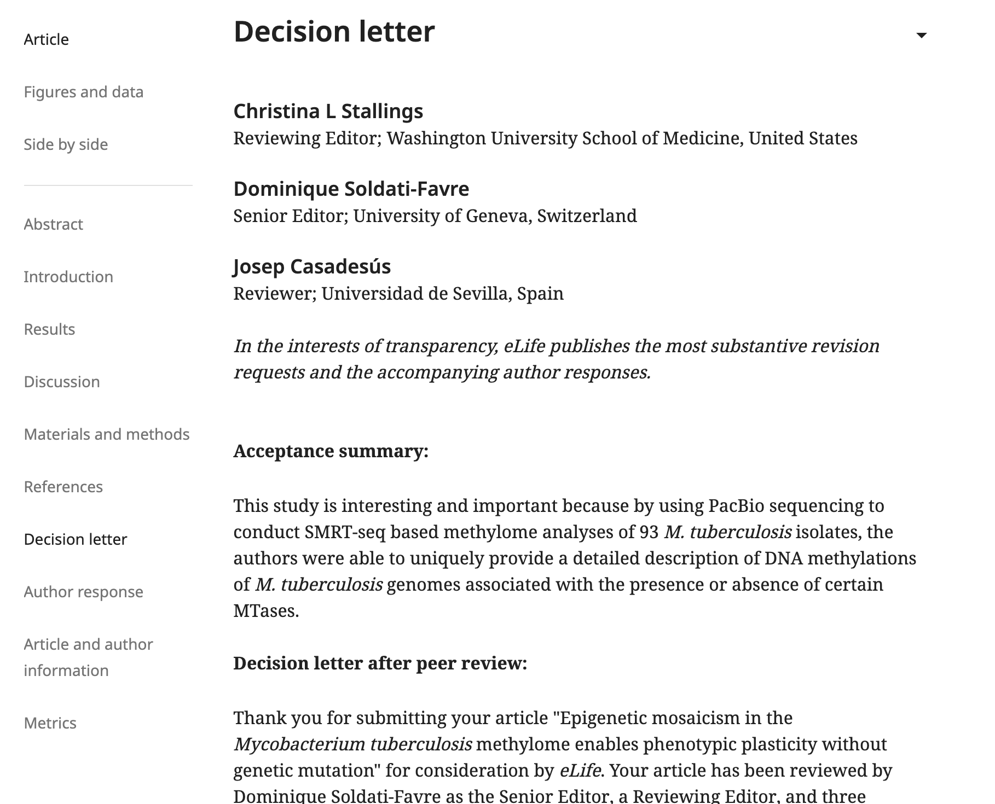
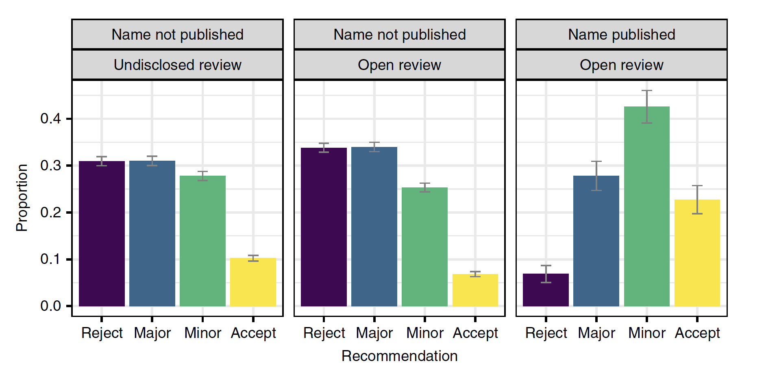
Transparent and/or signed peer reviews
To sign or not to sign?
Bravo et al. Nat. Comms. 2019

Slide 25
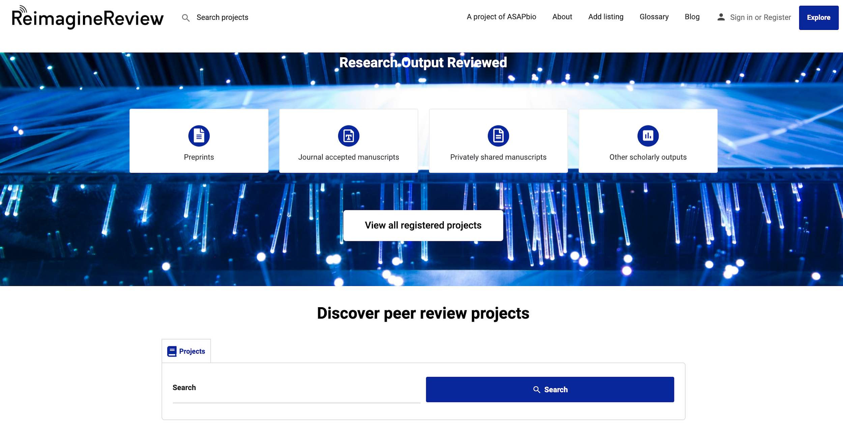

Slide 26
Decoupling peer review from the journal

Slide 27
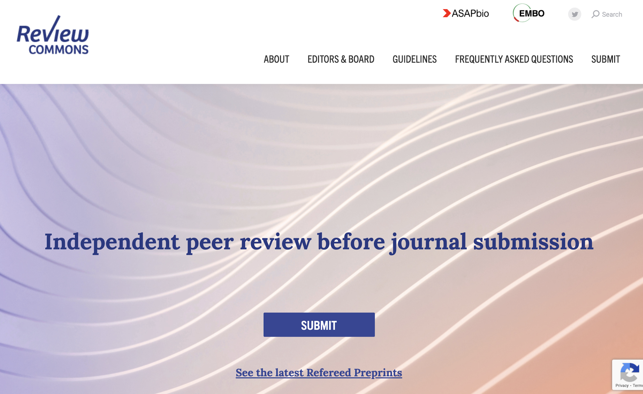
For a comparison of services in this area:
https://asapbio.org/comparing-review-services

Slide 28
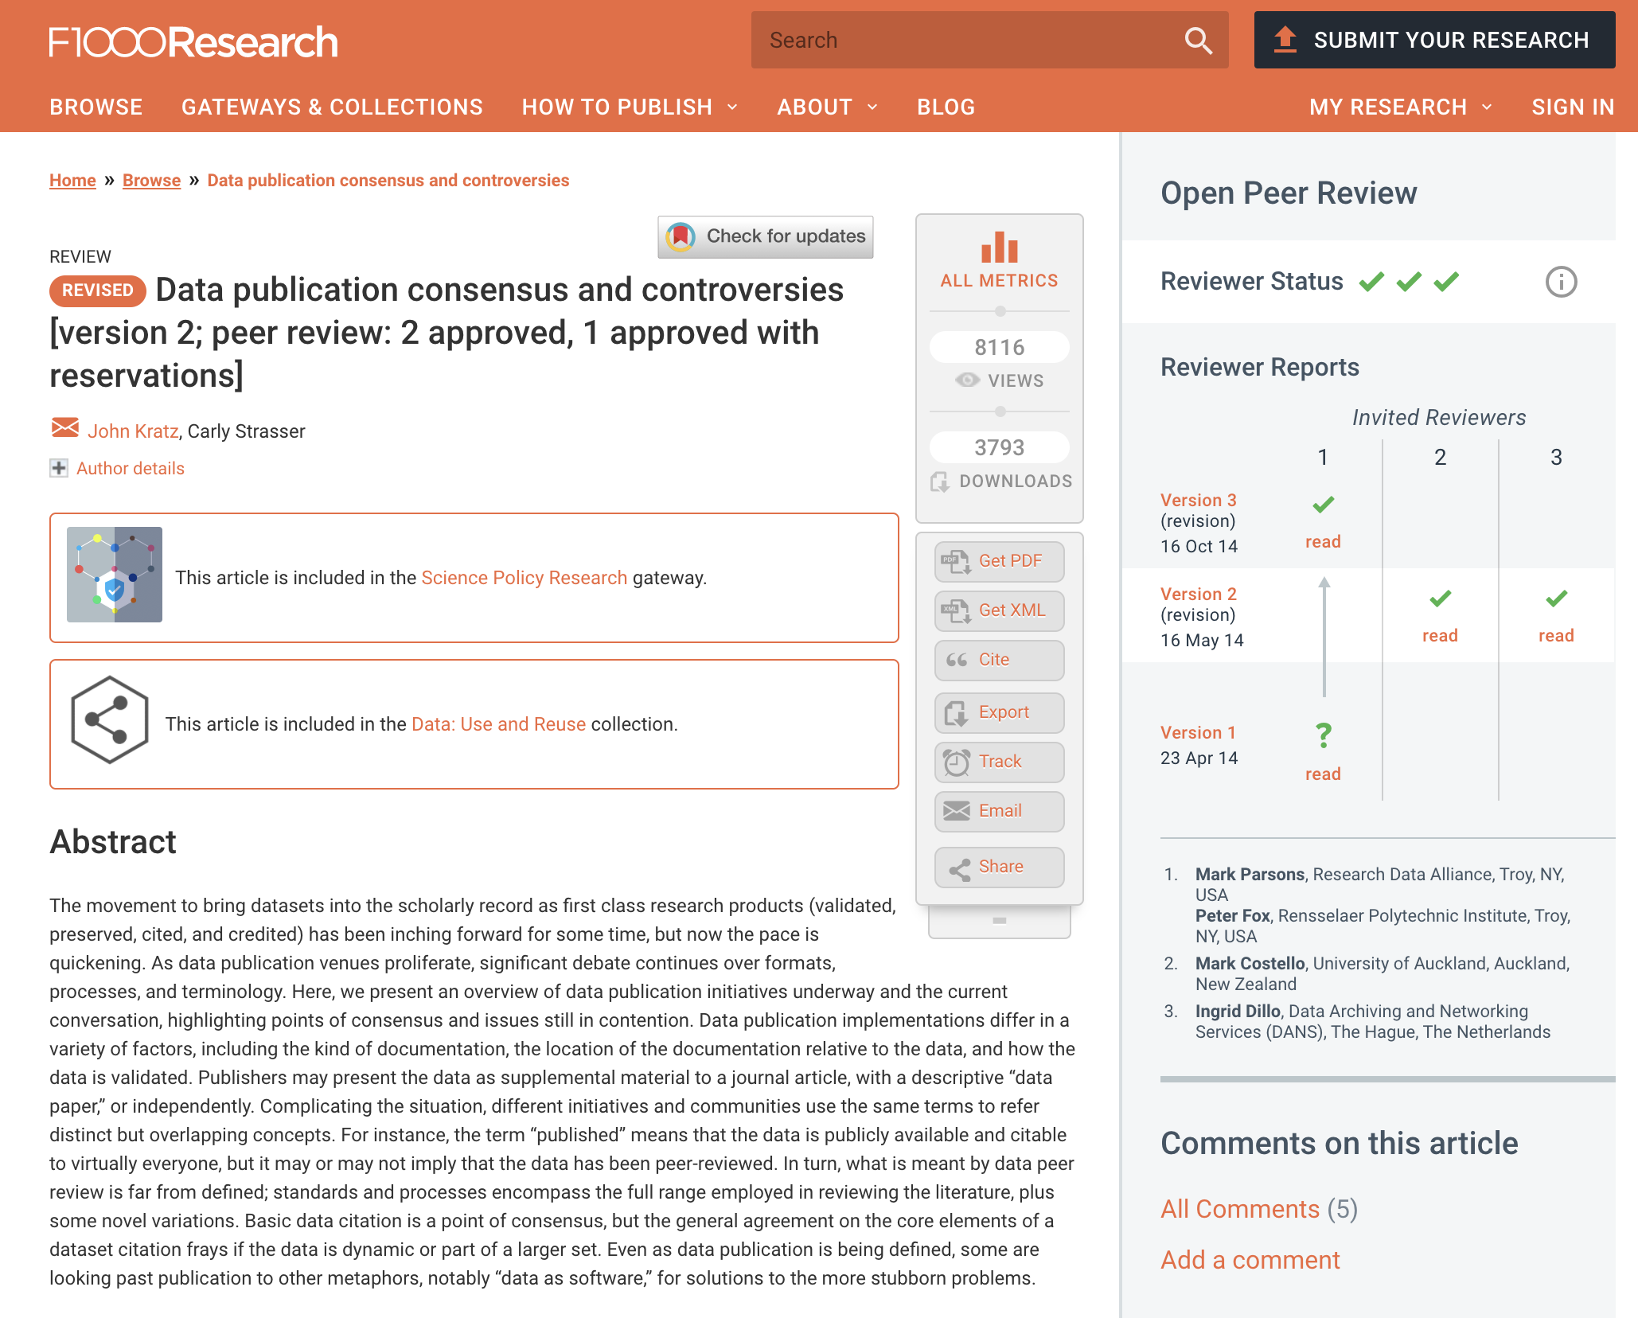





Post-publication peer review
Preprint peer review/
Overlay journals
Vs

Slide 29
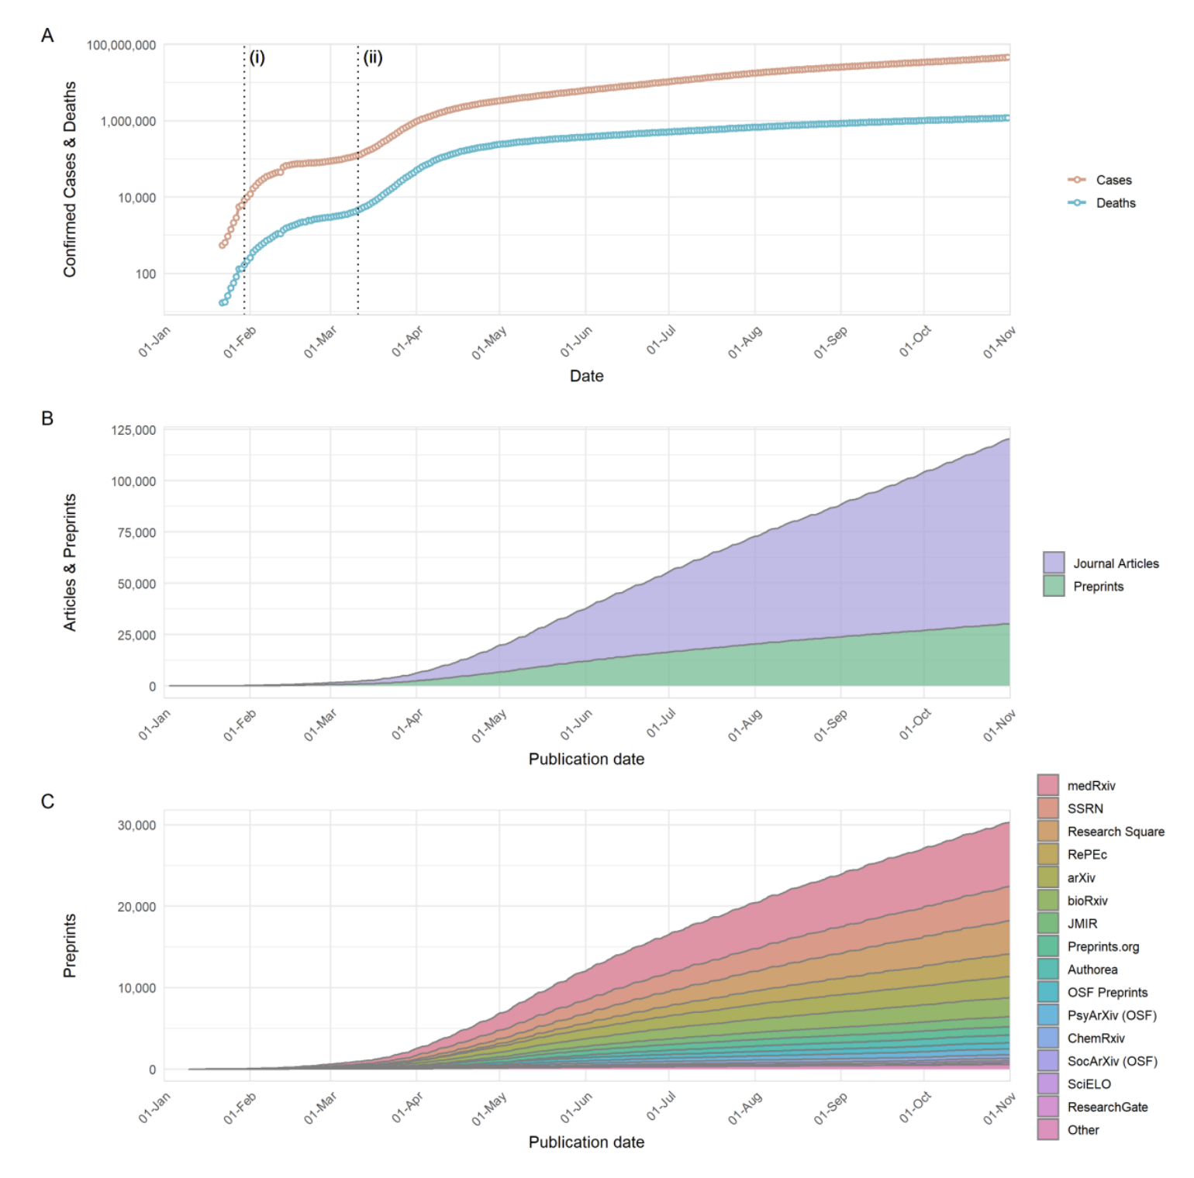
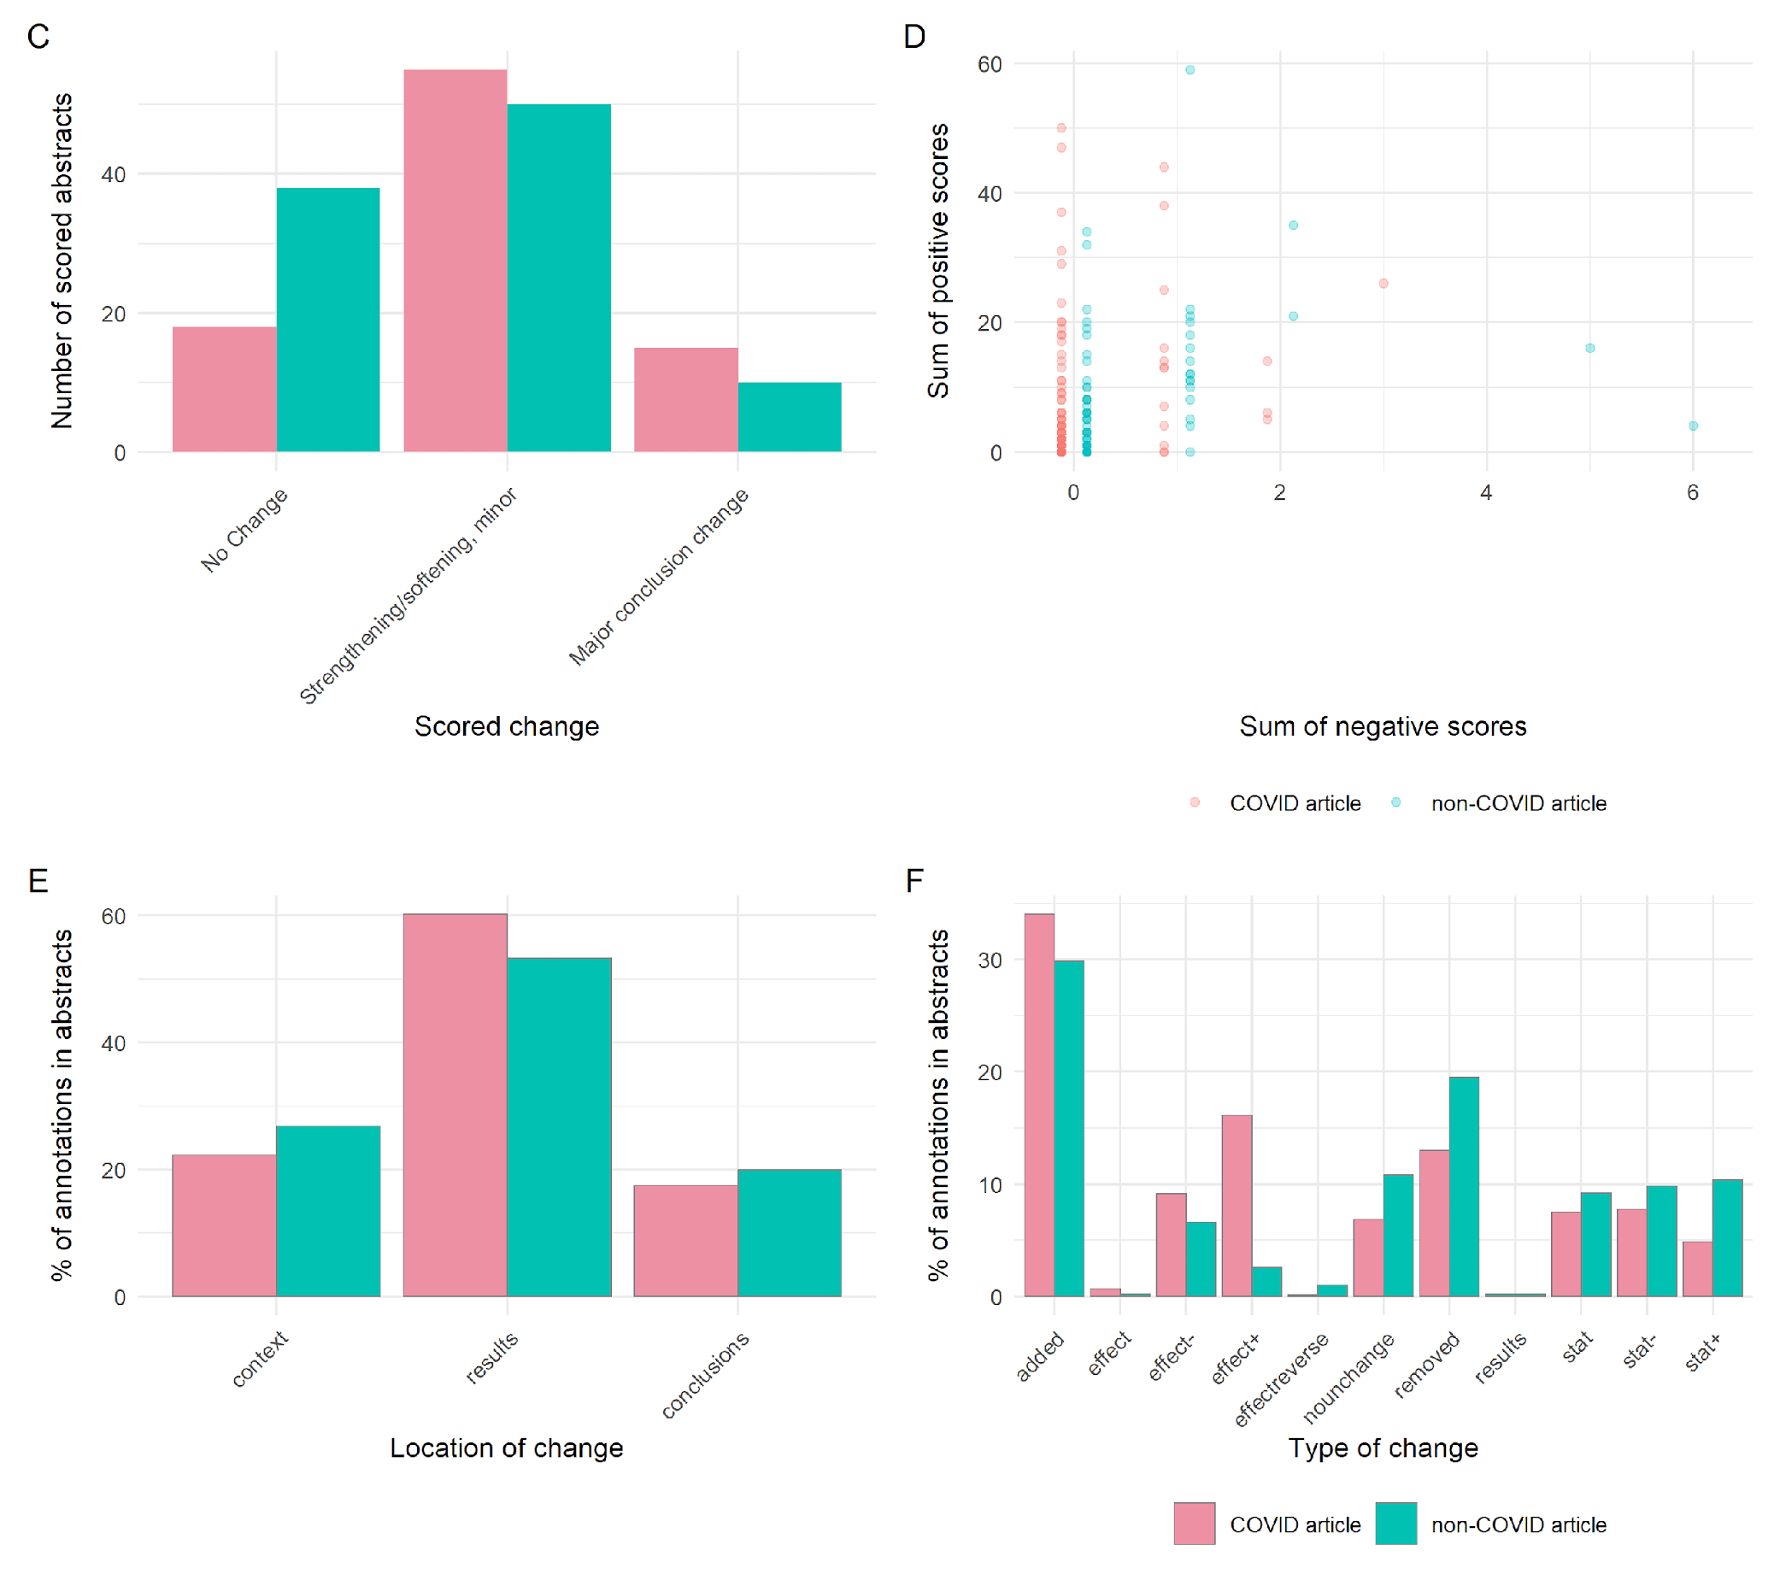
Assessing the quality of peer review
An explosion in preprinting, accelerated by COVID-19, provides an opportunity to rigorously examine peer review
Fraser et al. 2020; Polka et al. 2021 bioRxiv

Slide 30
What happens after acceptance?

Slide 31
Production editors: What do they do?
Editors
Scientific editors
Production editors
Editor in chief
Developmental editor
Associate/academic editor
Content editor
Before acceptance
Copyeditor
Proofreader
Post acceptance
Ensure compliance with language requirements and style guidelines such as AMA and APA
Notes:
After the initial checks, the manuscript is assigned to an editor that will handle the review process and communication with authors. Let’s take a look on the roles academic editors play in this process. Here we will group editors as scientific editors and production editors.
Note that, usually, scientific editors’ work takes place before acceptance, whereas production editors’ work takes place after acceptance.
The expertise lent and the extension of the revisions made define the role of an editor. The attributions and position title of an editor can vary greatly from journal to journal, therefore, the division presented here is an example, not stone-written rules. Moreover, the smaller the journal the more editors’ roles tend overlap. In this context, editors in chief could also work as developmental editors, whereas content editors would be more like associate editors, plus copyediting and proofreading tasks for both. Big publishers/journals tend to outsource services performed by production editors to academic publishing companies because it can be cost-effective and performed entirely after acceptance, not interfering with journal’s decisions.
Scientific editors are the ones we, as writers, reach when submitting a manuscript to a journal. They can be editors in chief or associate editors (and other position’s titles exist, it’s very particular of each publisher/journal), and their main responsibility is concerning scientific aspects of a given paper (eg, novelty, quality of evidence, and contribution to the field). They will perform the initial triage and send the manuscript to review or reject it. Workflows may begin with the editor in chief performing the initial triage, then assigning the manuscript to an associate editor who will handle reviewers’ assignments and the related communication.

Slide 32
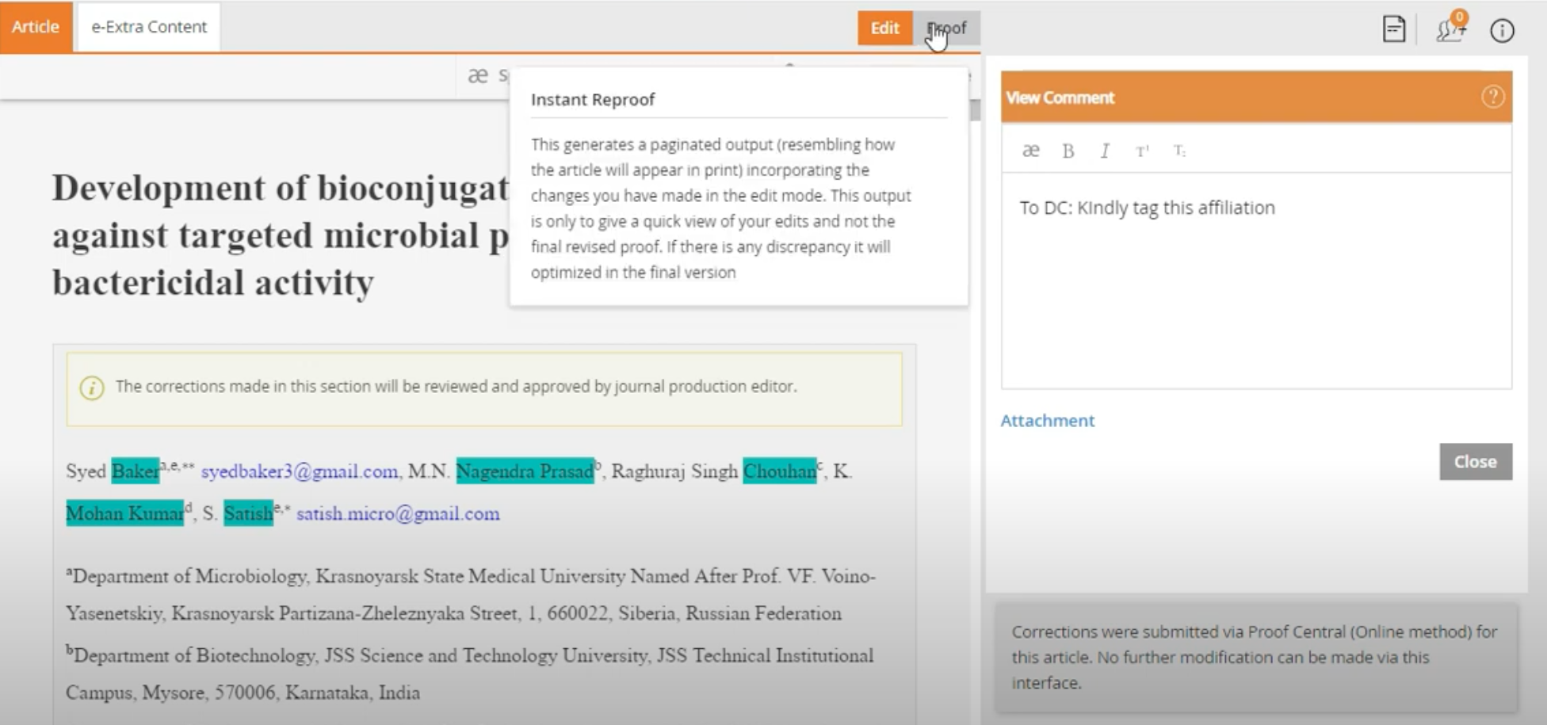
What happens after acceptance?
Once the Scientific Editor reaches a decision for acceptance, the manuscript is transferred to the Production Editors who will take steps to prepare the files for publication:
Document proof
copyediting
compliance with style & format requirements
check and enhance artwork quality
author proofing - the author may be sent a draft of the article for checking
https://www.youtube.com/watch?v=xXimclWTzBQ
Notes:
Guideline editors, on the other hand, are concerned with what could be called parnasian aspects of a paper, how to make it elegant and pleasant to read. A content academic editor focuses on the general conceptual intent, content, organization, and writing style of the work under consideration, while a developmental editor focuses on the larger picture, identifying gaps in logic and flow. A copyeditor focuses on spelling, punctuation, correct usage of grammar and style, while a proofreader merely marks queries for typesetters, editors, or authors, and the changes made, if any, are quite conservative.
In the production stage, the manuscript will be copyedited, sent for author proofing, and prepared to be first published.
After that, the manuscript will have metadata and identifiers added to it, artwork quality checked and enhanced, if needed, will be converted to XML and paginated. Of these steps, the addition of metadata and identifiers are certainly the most important ones.
The final version of the manuscript will be published as print, HTML, and/or PDF usually more than 6 months after its first online appearance.

Slide 33


Production Editors
Language and style editing: why bother?
The village blacksmith finally found an apprentice willing to work hard at a low pay for long hours.
When I take the shoe out of the fire, I’ll lay it on the anvil; and when I nod my head, you hit it with this hammer.
The apprentice did exactly as he was told. Now he is the village blacksmith.
Notes:
The village blacksmith finally found an apprentice willing to work hard at a low pay for long hours.
When I take the shoe out of the fire, I’ll lay it on the anvil; and when I nod my head, you hit it with this hammer.
The apprentice did exactly as he was told. Now he is the village blacksmith.
What went wrong there? (confusing instructions)

Slide 34
What happens after acceptance?
During production, the journal will also:
Invoice the author at this stage if there are any publication fees e.g.
Article-processing charges for Open Access journals
Any fees for figures or other services
Produce the final version of the journal article (Version of Record)
Assign a DOI
Add metadata and identifiers to the article
Convert the manuscript to XML
If the journal has print issues, assign pagination
Upon publication the journal will:
Make the article available on the journal website (PDF, HTML formats) and in print
Submit the article to indexing services such as PubMed, EuropePMC, Google Scholar etc
The editorial team may promote the article to the readers of the journal via editor highlights, press releases, social media
The production stage can take from 10 days to several months, depending on whether the journal publishes continuously or per issue, and whether there is print publication involved
Notes:
Guideline editors, on the other hand, are concerned with what could be called parnasian aspects of a paper, how to make it elegant and pleasant to read. A content academic editor focuses on the general conceptual intent, content, organization, and writing style of the work under consideration, while a developmental editor focuses on the larger picture, identifying gaps in logic and flow. A copyeditor focuses on spelling, punctuation, correct usage of grammar and style, while a proofreader merely marks queries for typesetters, editors, or authors, and the changes made, if any, are quite conservative.
In the production stage, the manuscript will be copyedited, sent for author proofing, and prepared to be first published.
After that, the manuscript will have metadata and identifiers added to it, artwork quality checked and enhanced, if needed, will be converted to XML and paginated. Of these steps, the addition of metadata and identifiers are certainly the most important ones.
The final version of the manuscript will be published as print, HTML, and/or PDF usually more than 6 months after its first online appearance.

Slide 35
Exercise #1
You are a scientific editor who just received a new submission, where the author has also posted a preprint.
What steps would you take to decide whether to send the paper to review?

Slide 36
Exercise #2
Let’s peer review!

Slide 37
General resources
A brief history of peer review
https://blog.f1000.com/2020/01/31/a-brief-history-of-peer-review/
https://www.stm-assoc.org/2015_03_04_STM_journal_at_350_Mabe.pdf
https://catalogues.royalsociety.org/CalmView/Record.aspx?src=Catalog&id=RR
The birth of modern peer review
https://blogs.scientificamerican.com/information-culture/the-birth-of-modern-peer-review/
Ugly side of peer review
https://www.elsevier.com/connect/editors-update/when-reviewing-goes-wrong-the-ugly-side-of-peer-review
Peer review and preprints https://blogs.biomedcentral.com/bmcblog/2017/05/05/the-history-of-peer-review-and-looking-forward-to-preprints-in-biomedicine/
Bias in peer review
https://asistdl.onlinelibrary.wiley.com/doi/full/10.1002/asi.22784?casa_token=nEayy_-NY2AAAAAA%3A1qkxK1uESg0wKtAr-0ltOEboMDYQbriBXeyp6BvBkEINzSr-rG4yVMvEFWpu2lmp72NaN-T7hoJV0HI

Slide 38
Resources Cont’d
The Editorial Process
https://www.councilscienceeditors.org/resource-library/editorial-policies/white-paper-on-publication-ethics/
https://www.elsevier.com/__data/assets/pdf_file/0005/95117/SC_FAQ-Role-of-an-Editor-22092014.pdf
http://publicationethics.org/files/Code_of_conduct_for_journal_editors_Mar11.pdf
https://bmcmedicine.biomedcentral.com/articles/10.1186/s12916-017-0927-0
https://theplosblog.plos.org/2019/11/why-engage-with-preprints/

